Slide 1
Not another forecast webinar
Data through December 2024
The webinar will begin shortly

Slide 2
Not another forecast webinar
Data through December 2024
“Thinking seriously about the future can be a worthwhile exercise, not because the future is knowable but because the process is likely to make us wiser.”
– John Mauldin (economist)
Notes:
When we imagine what could happen, we also think about what we will do if it happens. This prepares us to act more wisely when/if the forecast comes true.

Slide 3
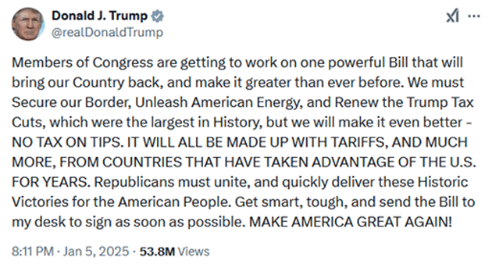
2025 Agenda
Secure the Border
Boost Energy Production
Renew Tax Cuts
Pay for everything with tariffs

Slide 4
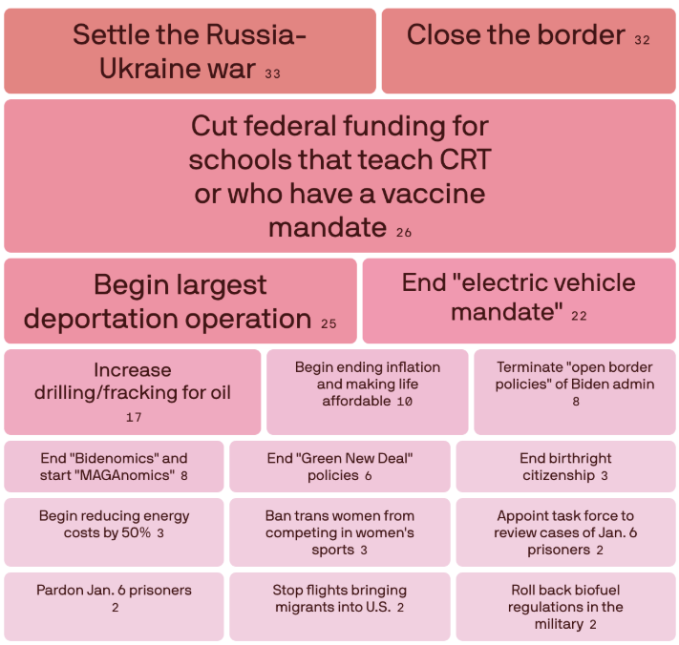
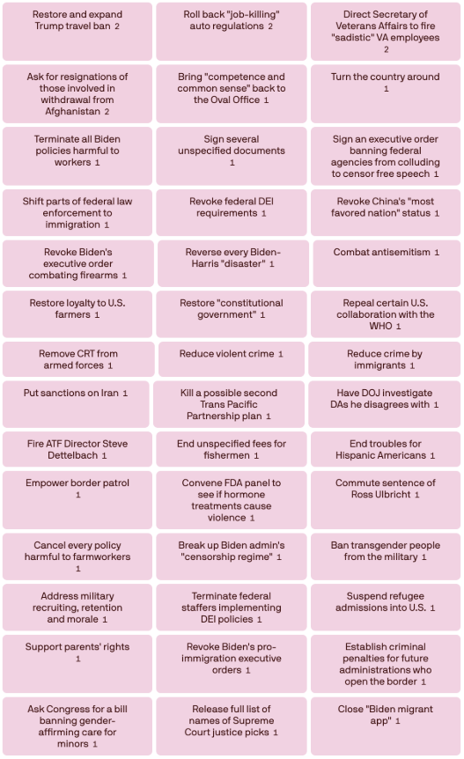

Slide 5
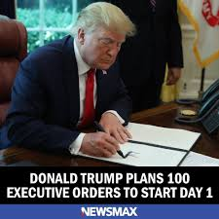
Inauguration Day Executive Orders
Directives to federal officials or agencies
Some effective immediately, others require additional time
Reverse/revoke prior executive orders
Cannot CHANGE laws
Cannot violate Constitution

Slide 6
Tariffs
Tax on consumers
Retaliatory tariffs could hurt US corporations
Creates uncertainty
WILL NOT pay for all the other agenda items
WILL NOT solve our trade deficit

Slide 7
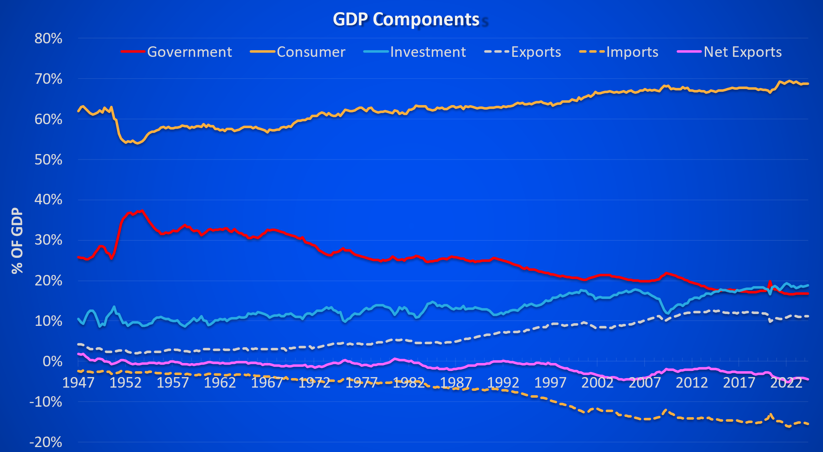
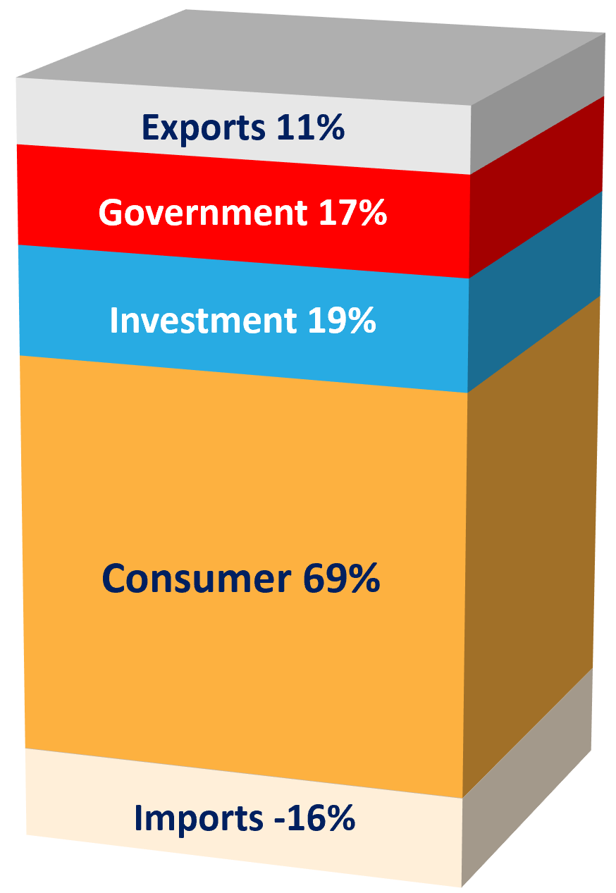
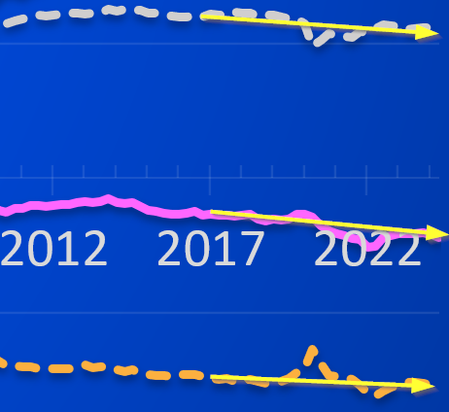
Did 2018-2024 Tariffs held trade deficit?

Slide 8
Other Polices
Secure the border (mass deportations)
Boost energy production (free market?)
Renew & expand tax cuts (deficit?)

Slide 9
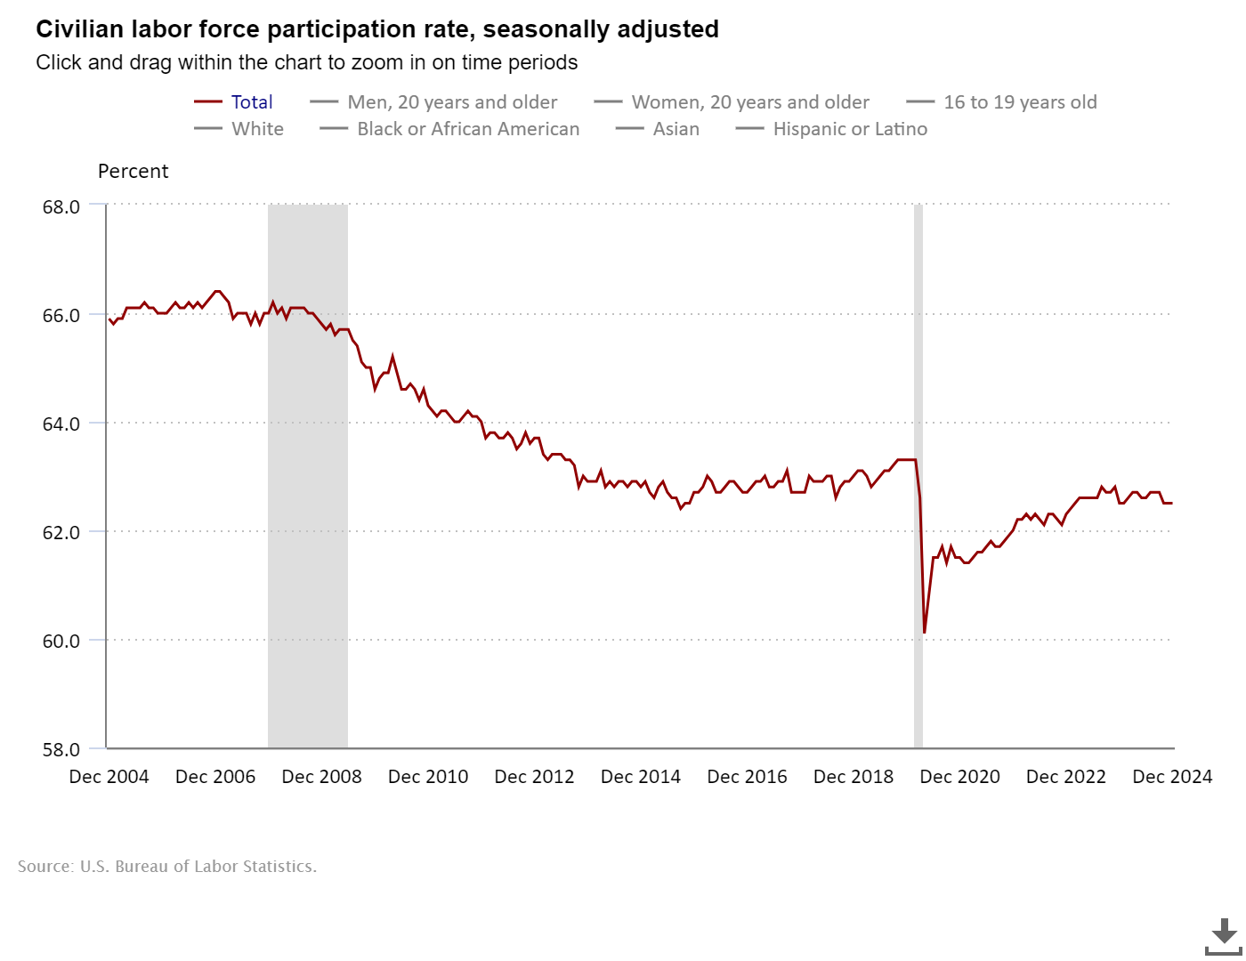
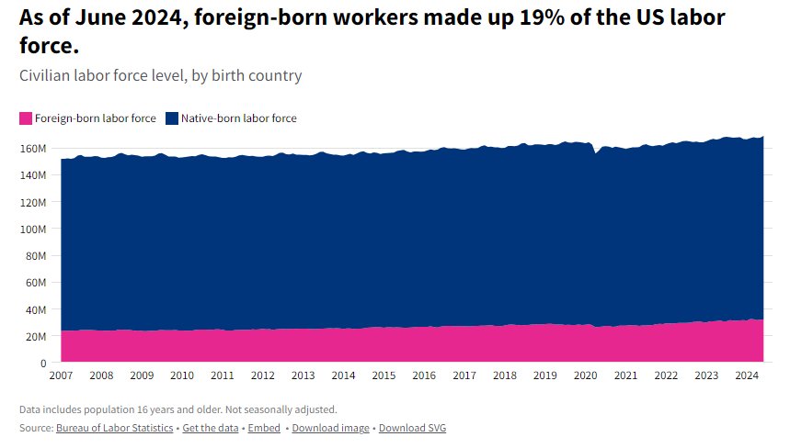
Who is going to work?
INFORMATIONAL PURPOSES ONLY | NOT INVESTMENT ADVICE

Slide 10
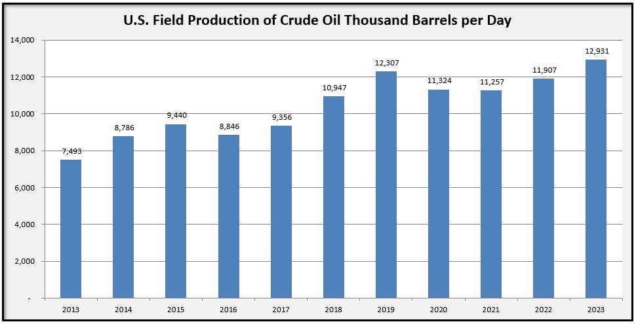
Did “Biden” boost production?
12,032
Avg.
10,983 Average
INFORMATIONAL PURPOSES ONLY | NOT INVESTMENT ADVICE

Slide 11
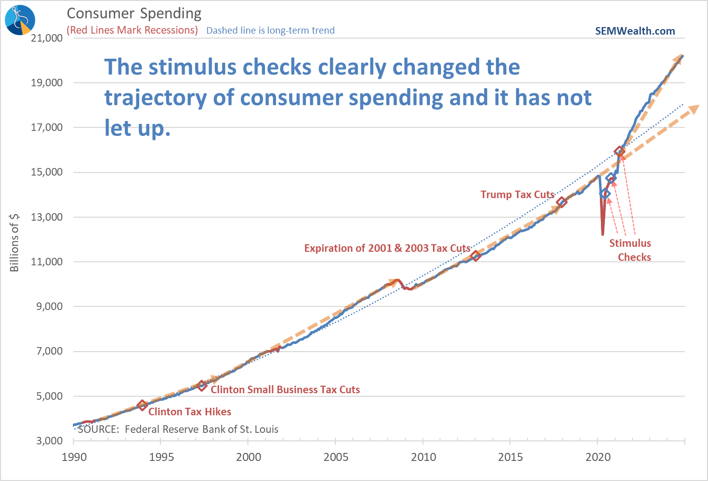
Did tax cuts help?
INFORMATIONAL PURPOSES ONLY | NOT INVESTMENT ADVICE

Slide 12
What about DOGE?
GOAL: Eliminate ‘government waste’
$3 Trillion initial goal, now $500 Billion
Top idea: cut federal employees (estimated 1.5 million jobs to save $150 Billion)
Interest expense included in initial list of “waste”

Slide 13
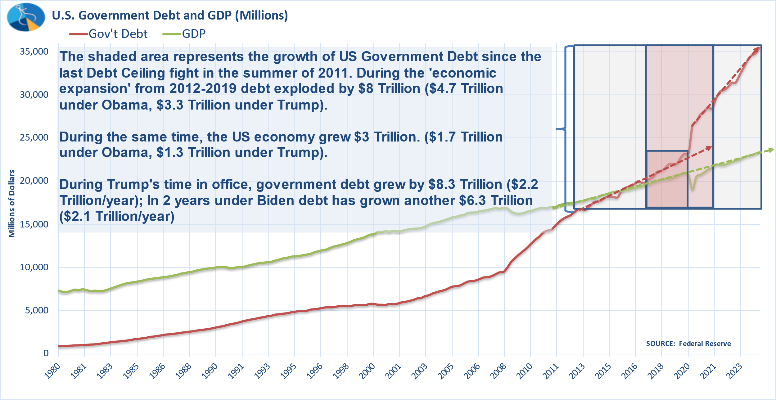
Do we need DOGE?
Notes:
Welfare: Cash welfare, food stamps, unemployment benefits, workers compensation, housing, excluding health care
Other Spending: Police, fire, law courts, prisons; Legislative, executive, finance; Research, economic development, agriculture, energy, environment; Interest on government debt
Transportation: Road, rail, airports

Slide 14
Where can DOGE cut waste?
Welfare: Cash welfare, food stamps, unemployment benefits, workers compensation, housing, excluding health care
Other Spending: Police, fire, law courts, prisons; Legislative, executive, finance; Research, economic development, agriculture, energy, environment; Interest on government debt
Transportation: Road, rail, airports
Notes:
Welfare: Cash welfare, food stamps, unemployment benefits, workers compensation, housing, excluding health care
Other Spending: Police, fire, law courts, prisons; Legislative, executive, finance; Research, economic development, agriculture, energy, environment; Interest on government debt
Transportation: Road, rail, airports

Slide 15
Where can DOGE cut waste?
Notes:
Welfare: Cash welfare, food stamps, unemployment benefits, workers compensation, housing, excluding health care
Other Spending: Police, fire, law courts, prisons; Legislative, executive, finance; Research, economic development, agriculture, energy, environment; Interest on government debt
Transportation: Road, rail, airports

Slide 16
Where can DOGE cut waste?
Welfare: Cash welfare, food stamps, unemployment benefits, workers compensation, housing, excluding health care
Other Spending: Police, fire, law courts, prisons; Legislative, executive, finance; Research, economic development, agriculture, energy, environment; Interest on government debt
Transportation: Road, rail, airports
Notes:
Welfare: Cash welfare, food stamps, unemployment benefits, workers compensation, housing, excluding health care
Other Spending: Police, fire, law courts, prisons; Legislative, executive, finance; Research, economic development, agriculture, energy, environment; Interest on government debt
Transportation: Road, rail, airports

Slide 17
Where can DOGE cut waste?
Welfare: Cash welfare, food stamps, unemployment benefits, workers compensation, housing, excluding health care
Other Spending: Police, fire, law courts, prisons; Legislative, executive, finance; Research, economic development, agriculture, energy, environment; Interest on government debt
Transportation: Road, rail, airports
Notes:
Welfare: Cash welfare, food stamps, unemployment benefits, workers compensation, housing, excluding health care
Other Spending: Police, fire, law courts, prisons; Legislative, executive, finance; Research, economic development, agriculture, energy, environment; Interest on government debt
Transportation: Road, rail, airports

Slide 18
Understanding the Potential GDP Equation
(
)
+
How many people are working?
How much are they producing?
(
)
+
Net Exports
Interest Expense

Slide 19
What could go wrong in 2025?
Economic growth slows
Inflation heats up again
Markets cannot meet lofty expectations

Slide 20
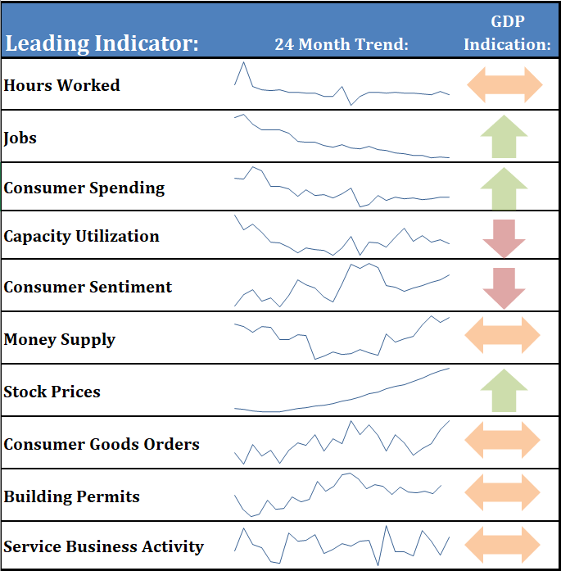
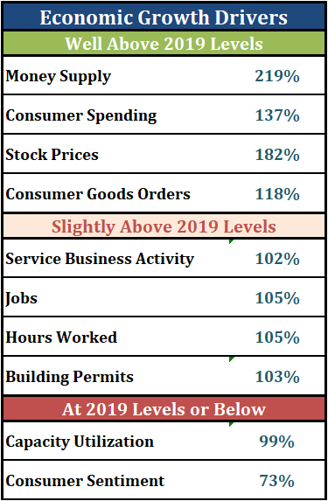
Economic indicators are mixed

Slide 21
Will inflation continue to drop?

Slide 22
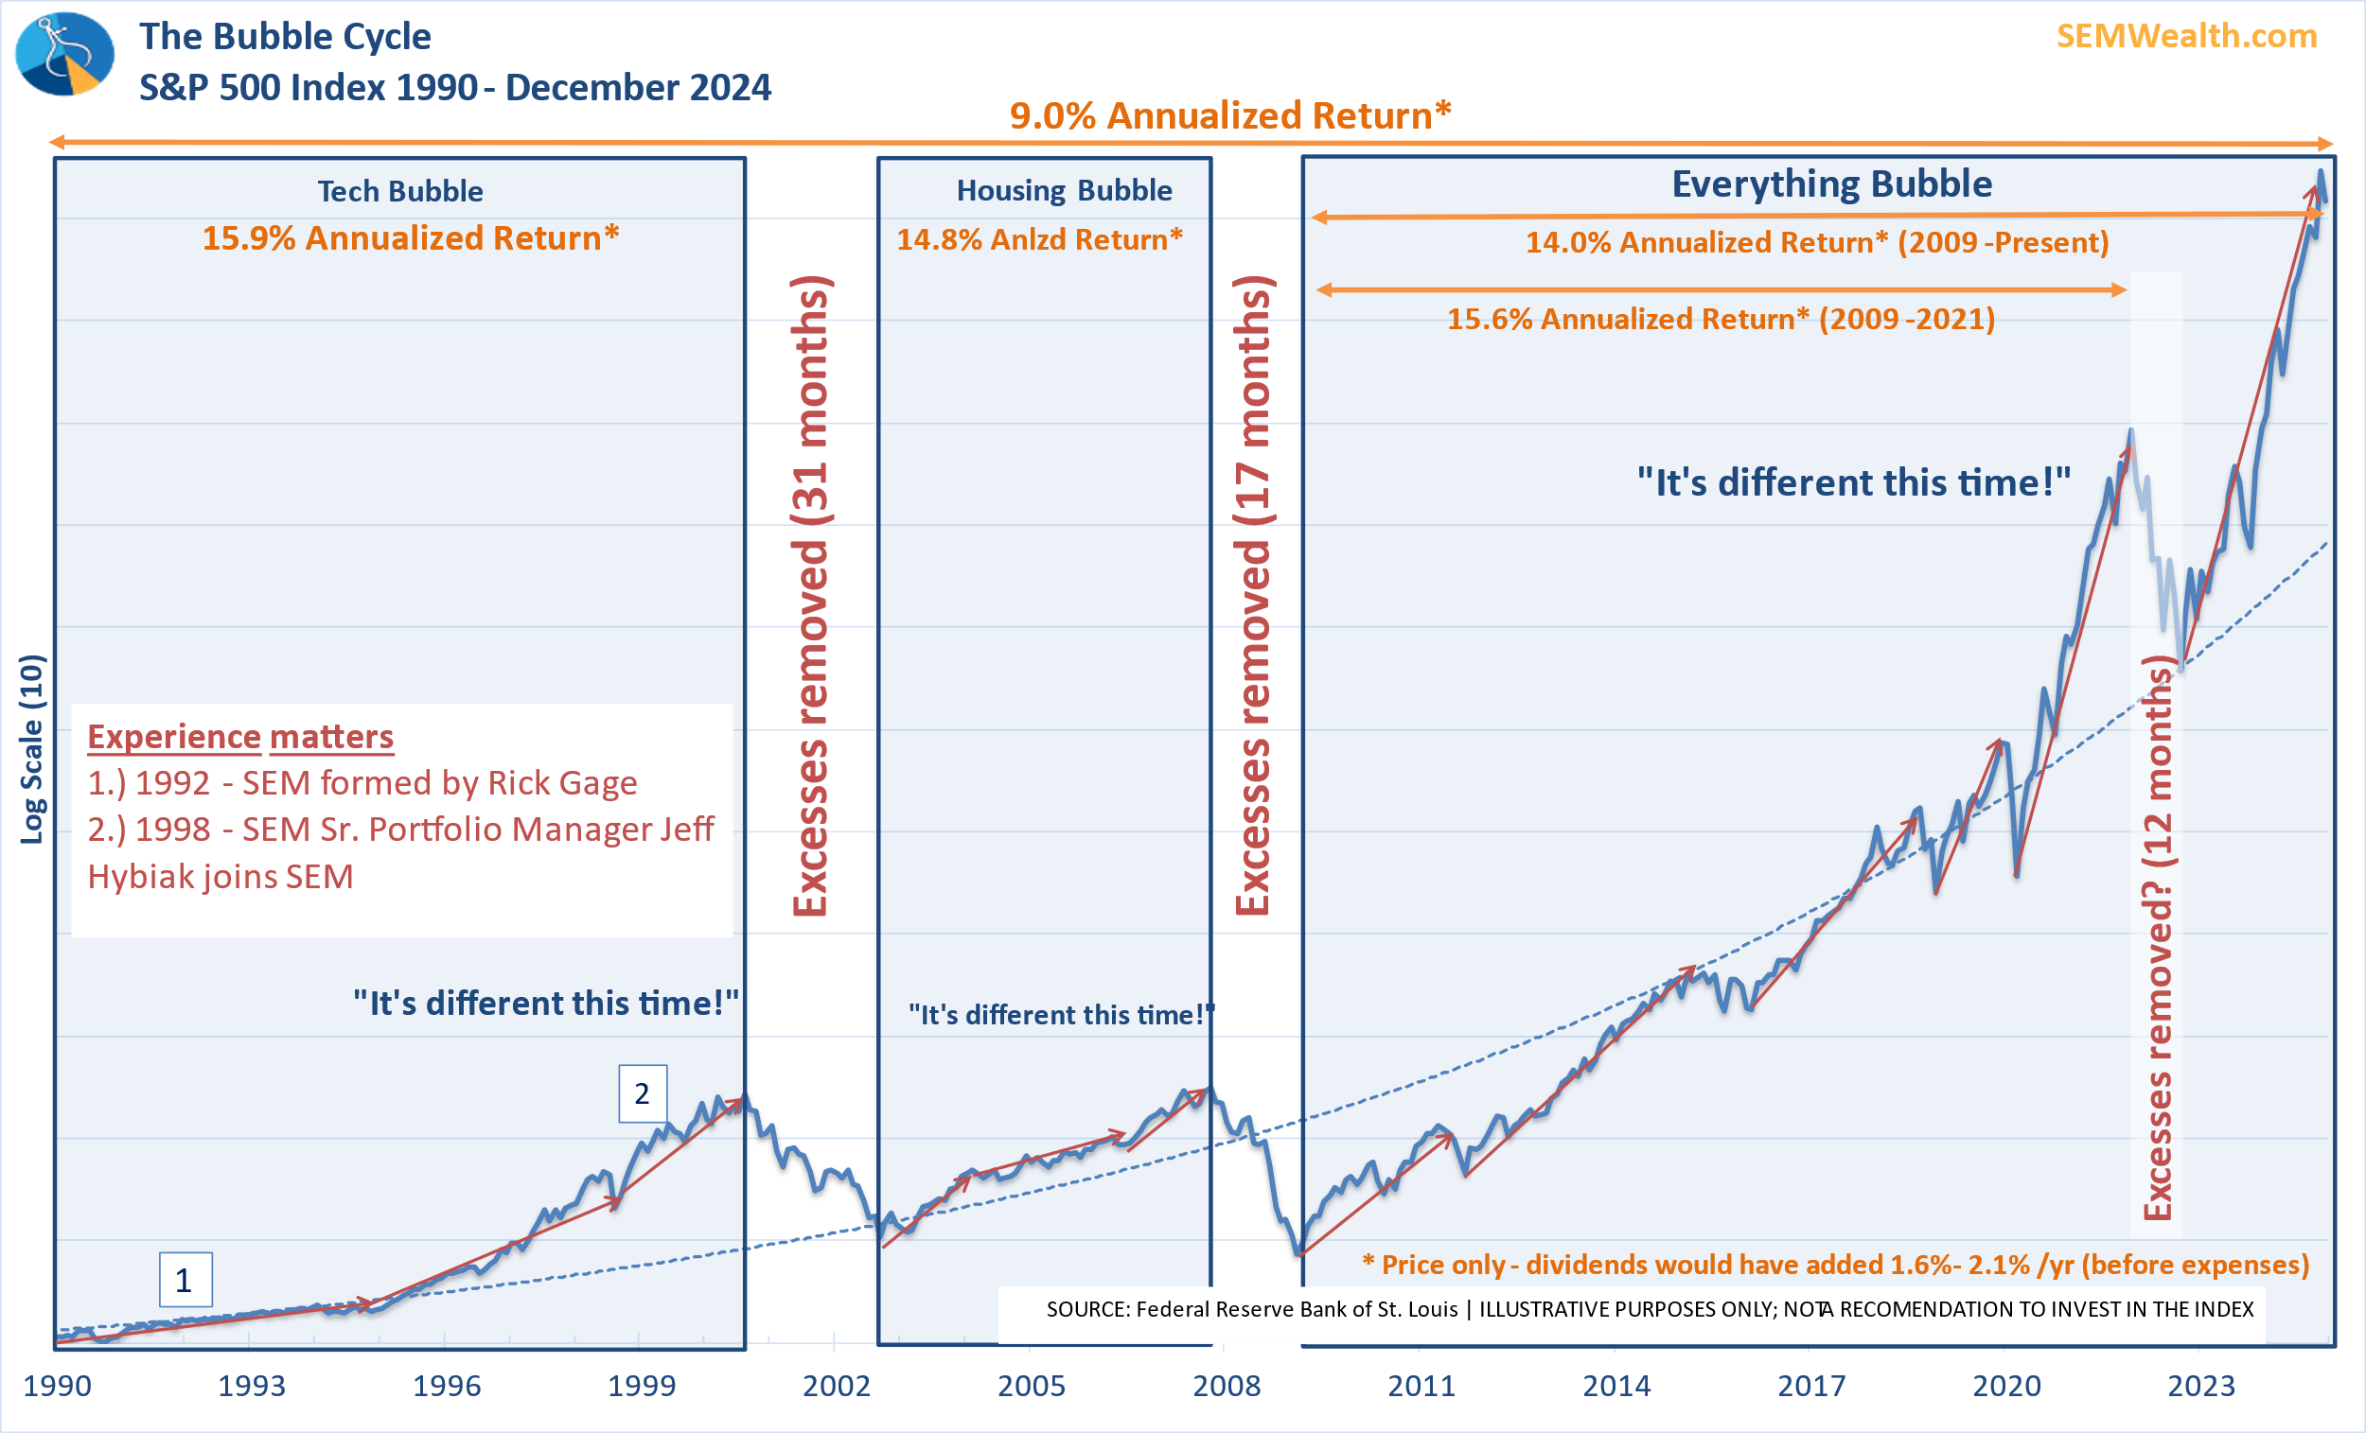
When will excesses be removed?
Notes:
Highlight the bubble returns versus the long-term average
It is important as we assess our practices to look at the big picture. I always challenge people who want to increase their exposure to stocks at the current time to explain to me the logic.
Since 1990, stocks have compounded at just over 9%. This is the same number they have compounded at going back to the 1920s, 1950s, 1970s, and 1980s. Anytime we have seen mid-teen compounded returns for a long period of time, stocks have sharply corrected to their mean.
Again going back to those assessment questions – how will your client base, your portfolio mix, and your business handle a 35-50% drop in stock prices?

Slide 23
SEM’s 2025 Gameplan
Enjoy the trend
Do not chase the manias
Have an exit strategy

Slide 24
Why use a Behavioral Approach?
Stock Market Cycle
1.) Long-term growth = GDP Growth + Dividend Yield + Inflation
2.) Stock Prices over-anticipate long-term growth and then under-anticipate the economic slowdown.
…or we are here
We are either here…
Value
INFORMATIONAL PURPOSES ONLY | NOT INVESTMENT ADVICE
We are better off here
Goals of SEM’s Behavioral Portfolio:
Reduced market exposure when signs of overheating appear
Minimize market exposure when signs of looming recession appear
Maximize market exposure when signs of recovery appear
ILLUSTRATIVE PURPOSES ONLY
Time
Notes:
In general this is how it looks. Each customized portfolio will end up with a maximum and minimum exposure to the stock market. Over the long-run stocks should outperform, but remember rule #1 – stocks will overreact in both directions.
Looking at this chart, this is generally how our exposure fluctuates. We won’t get out right at the top or back in right at the bottom. This allows us to focus on rule #2 – managing losses is important.

Slide 25
Understanding Human Behavior
The stock market is a story of cycles & of the human behavior that is responsible for overreactions in both directions.
– Seth Klarman
For current market updates go to: tradersblog.semwealth.com
Notes:
First, let’s take a look at what Behavioral Finance is.
My #1 rule of investing is not Buy Low / Sell High, instead it is this quote from Seth Klarman – human behavior will lead to overreactions in both directions.
We must be aware of our emotions. We’ve been discussing the behavioral cycle of investors for over 20 years. These are the emotions psychologists said we all experience at various times. Now each person is different, but each person to some degree will go through this cycle.
The consensus of the market is what matters in the big picture. I argued at the start of the year the market was euphoric. Everyone was downright giddy looking at the prospects of stocks as we started the year.
(Animation) As the Coronavirus came to our shores in late February we saw Anxiety kick in and then a rapid move down in March.
After the Fed stepped in with some massive programs to stop the bleeding, the markets reversed back-up. (Animation) Based on my experience managing money the last 25 years I’m seeing some people who are downright delusional if not euphoric about the recovery. Overall, I believe the market is in the denial phase. We had structural issues before COVID and the solutions have created even greater structural issues.
The key here is our brains do not like surprises. They like the rush of making money and begin to believe it is “normal”. When reality sets in our brains can react harshly, which can lead to severe damage to the financial plan. Advisors are prone to these same emotions.

Slide 26
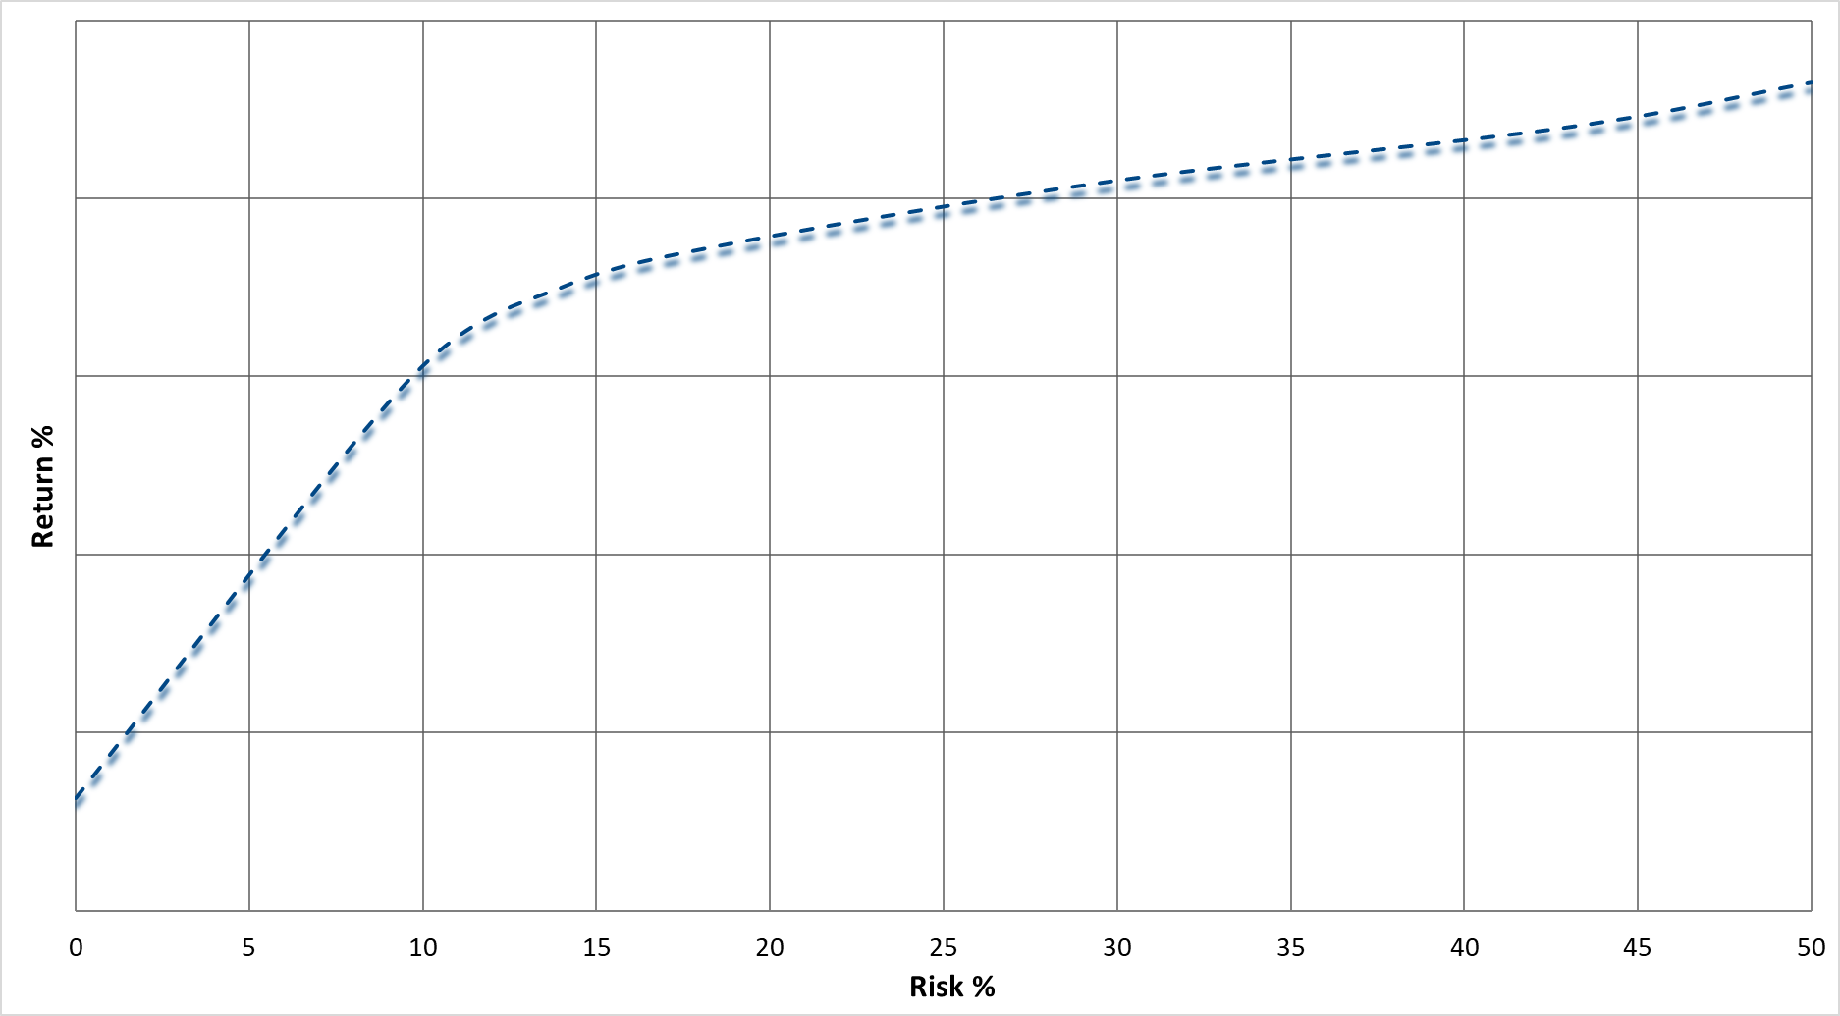
Process in Motion – Allocations as of 12/31/2024
Bucket 1
(immediate)
0 to 3 yrs
Bucket 2
(short-term)
3 to 5 yrs
Bucket 3
(intermediate-term)
6 to 15 yrs
Bucket 4
(long-term)
15 -25 yrs + (based on risk)
Bucket 5
(long-term)
25 yrs + (based on risk)
Current Stock Allocation %
Dynamic Aggr. [DAG]
CS/AG
Max
Current High Yield Bond Alloc %
CS/AG
Growth
Strategic Stock Portfolios*
AG
Moderate
Enh.
Growth
[EGA]
MF-AGR [85/15]
70 – 100% stocks
50 – 100% stocks
stocks
Current Floating Rate Bond Alloc %
100%
100%
Dynamic Balanced [DBA]
90%
MF-GRW [70/30]
Current Cash/MMKT Alloc %
CS/AG
Balanced
50 – 90% stocks
CS
Income
[CS-INC]
Dynamic Income [DIA]
MF-MGRW [60/40]
70%
CS
Bond [CS-BND]
MF-BAL [50/50]
25 – 70% stocks
100%
30 – 70% stocks
70%
MF-MCSV [40/60]
Tactical Bond [TB]
Multi-Asset
0-120% equities
100%
MF-CON [30/70]
Strategic Bond Portfolios*
45%
Income
Alloc.
[INA]
70%
30%
0 – 40% stocks
0 – 40% stocks
TaxAdv Bond [TAB]
60%
SEM Management Styles
25%
20%
20%
Index Fund Allocations
[STOCK % /
BOND %]
CASH [0/100]
15%
Tactical Models
(Daily)
Dynamic Models
(Monthly)
Strategic Models
(Quarterly)
100%
*Strategic (Low Cost) Portfolios:
Bonds: Core-Bond, Core-Muni, ESG-CB, MF-INC
Stocks: Core-Stock, ESG-CS, MF-EQT
Passive “Efficient Frontier”
Notes:
What we’ve found in practice is it is best to combine multiple investment strategies to take advantage of the different factors. In addition to the AmeriGuard and Cornerstone models I discussed, we also use factors based on our economic model and in the fixed income markets. The key is all of these is they are designed to fit with the overall plan. This also helps to segment off the portfolio into specific buckets and allows clients to stay invested in the overall portfolio.
At SEM we create a customized portfolio. We actually have three distinct investment styles with three different processes. In brief………….
Let’s use the median risk tolerance level of 20% as an example. Our goal is to have as much money invested in the stock market, so that would lead to us using our “strategic” models – either Cornerstone or AmeriGuard. We usually start with one that matches your personality. Let’s use Growth.
We then want to use a Dynamic model, which uses SEM’s economic model to adjust allocations. With a 20% risk tolerance we’d probably use Dynamic Income to offset some of the risks of the Growth model.
Finally, we’d use our Tactical Models to pull the risk down even more. These models are watched daily and are designed to lower the overall risk in the account. Tactical Bond is our most popular and useful model in this sense. We also have a Biblically Responsible Cornerstone Bond model as well.
The blended portfolio gives you a truly unique experience. Having the money in different “buckets” is a way to keep you invested with your long-term money because the other buckets are pulling the risk in the portfolio down. The beauty of this is it can be adjusted at any time via our online Risk Questionnaire.
HERE IS THE KEY: At SEM we’ve created a platform where your biases can be overcome. With 3 distinct investment strategies and a wide range of models, including those which utilize outside investment managers you don’t have to be right with your investment outlook. You can still take advantage of the various factors along with any new innovations that take place in the future. You can focus on what you do best – financial planning.

Slide 27
A Behavioral Portfolio Approach

STEP
5
Use smaller portions of portfolio for concentrated or riskier investments.
STEP
4
Select investments that align with specific objectives and risk levels for that layer.
STEP
3
Divide assets into specific layers and set specific goals and objectives for each layer.
STEP
2
Develop cash flow strategy taking into consideration cash and other low risk investments. This reduces short-term risk and the likelihood of making short-term, emotional decisions.
STEP
1
Construct complete financial plan with specific goals and objectives.
Notes:
Let’s go back to our Behavioral Portfolio Pyramid. This is the key reason it is segmented. You don’t have to do ALL of them. In fact, we’ve found successful advisors focus on what they are good at and outsource the rest.
Whether you decide to do all of this yourself is truly up to you, what you enjoy doing, and where you want your practice to go.

Slide 28
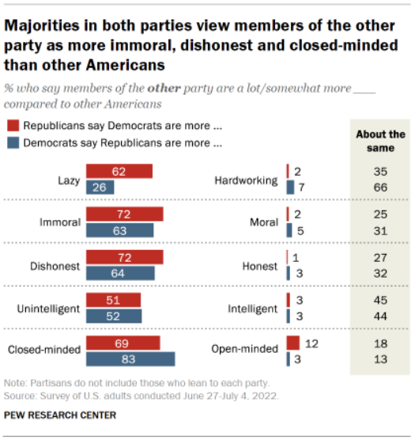
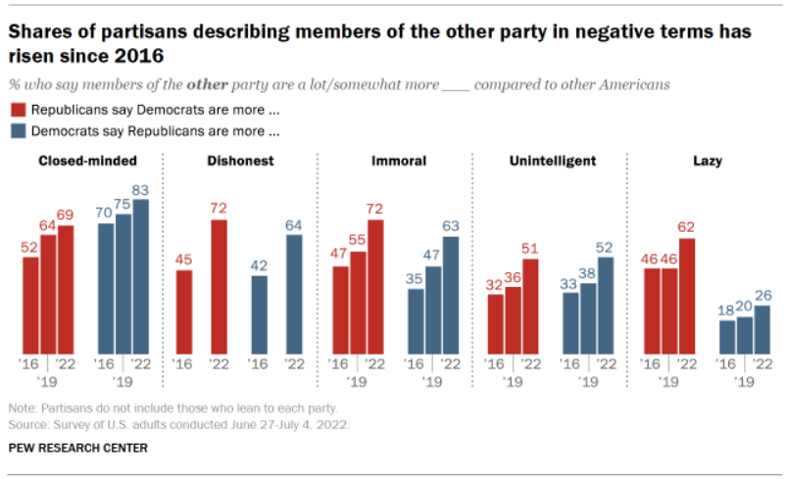
United we stand, divided we fall?
Notes:
Patrick Henry – 1799 "Let us trust God, and our better judgment to set us right hereafter. United we stand, divided we fall.
(also Jesus in Matthew 12:25 -- every kingdom divided against itself will be ruined, and every city or household divided against itself will not stand.”)

Slide 29
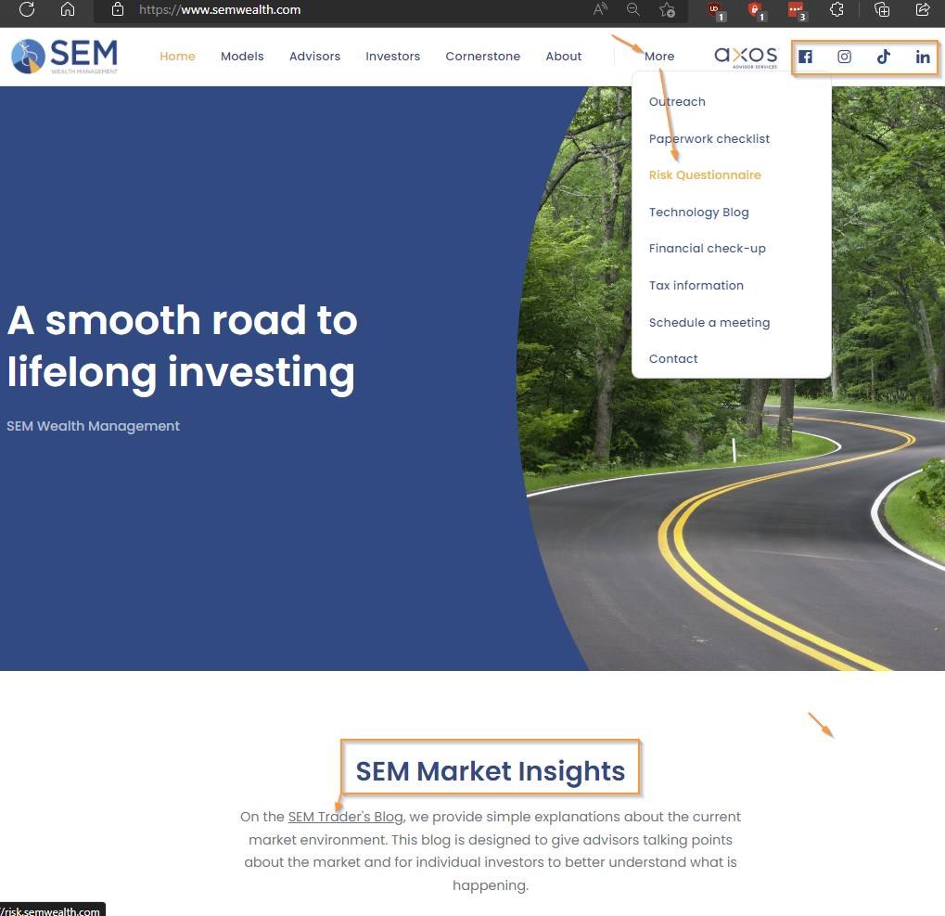
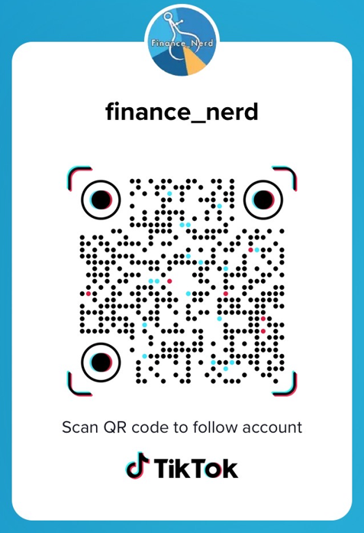
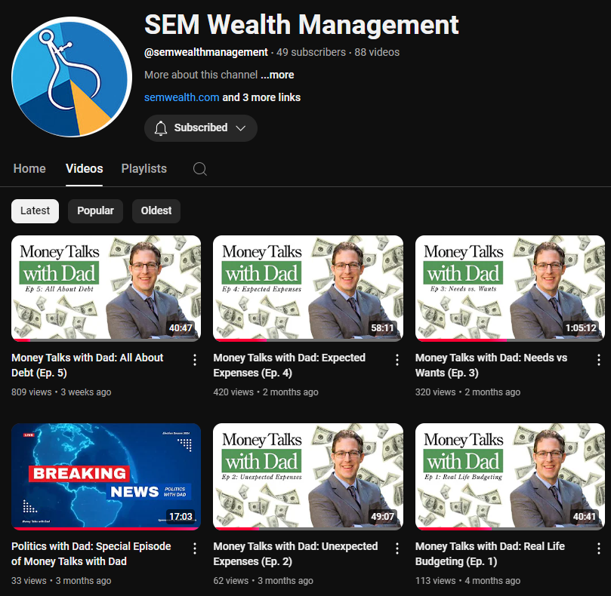
For more information go to
SEMWealth.com
Notes:
A lot of resources – check out our blog under the Market Insights tab --- use our risk questionnaire
Follow us on social media (including TikTok and Instagram)
Thank you for your time. I’d encourage you to check out our website. We’ve been posting all kinds of content in the blog. There’s a subscribe link if you’d like to stay up-to-date. We also have our risk questionnaire available. It’s 10 questions and we’ll forward the results to your investment advisor to start a conversation about your portfolio.
Let’s see if we have any questions…….

Slide 30
QUESTIONS?
“Extra interested in bullet point 2, what the president can and cannot do (on inauguration day or any other)”
-J Morgan

Slide 31
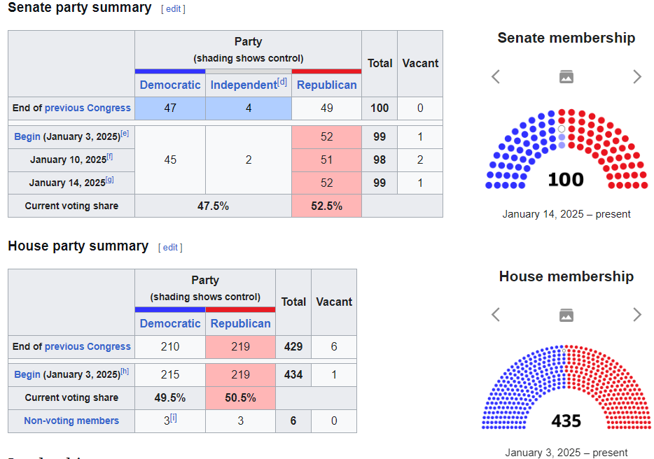
What the President Can & Cannot Do
Executive Orders:
Directives to federal officials or agencies
Some effective immediately, others require additional time
Reverse/revoke prior executive orders
Cannot CHANGE laws
Cannot violate Constitution

Slide 32
Independents control the vote

Slide 33
QUESTIONS?
“I would like to see a short and long-term tax overview”
-P. Zellner

Slide 34
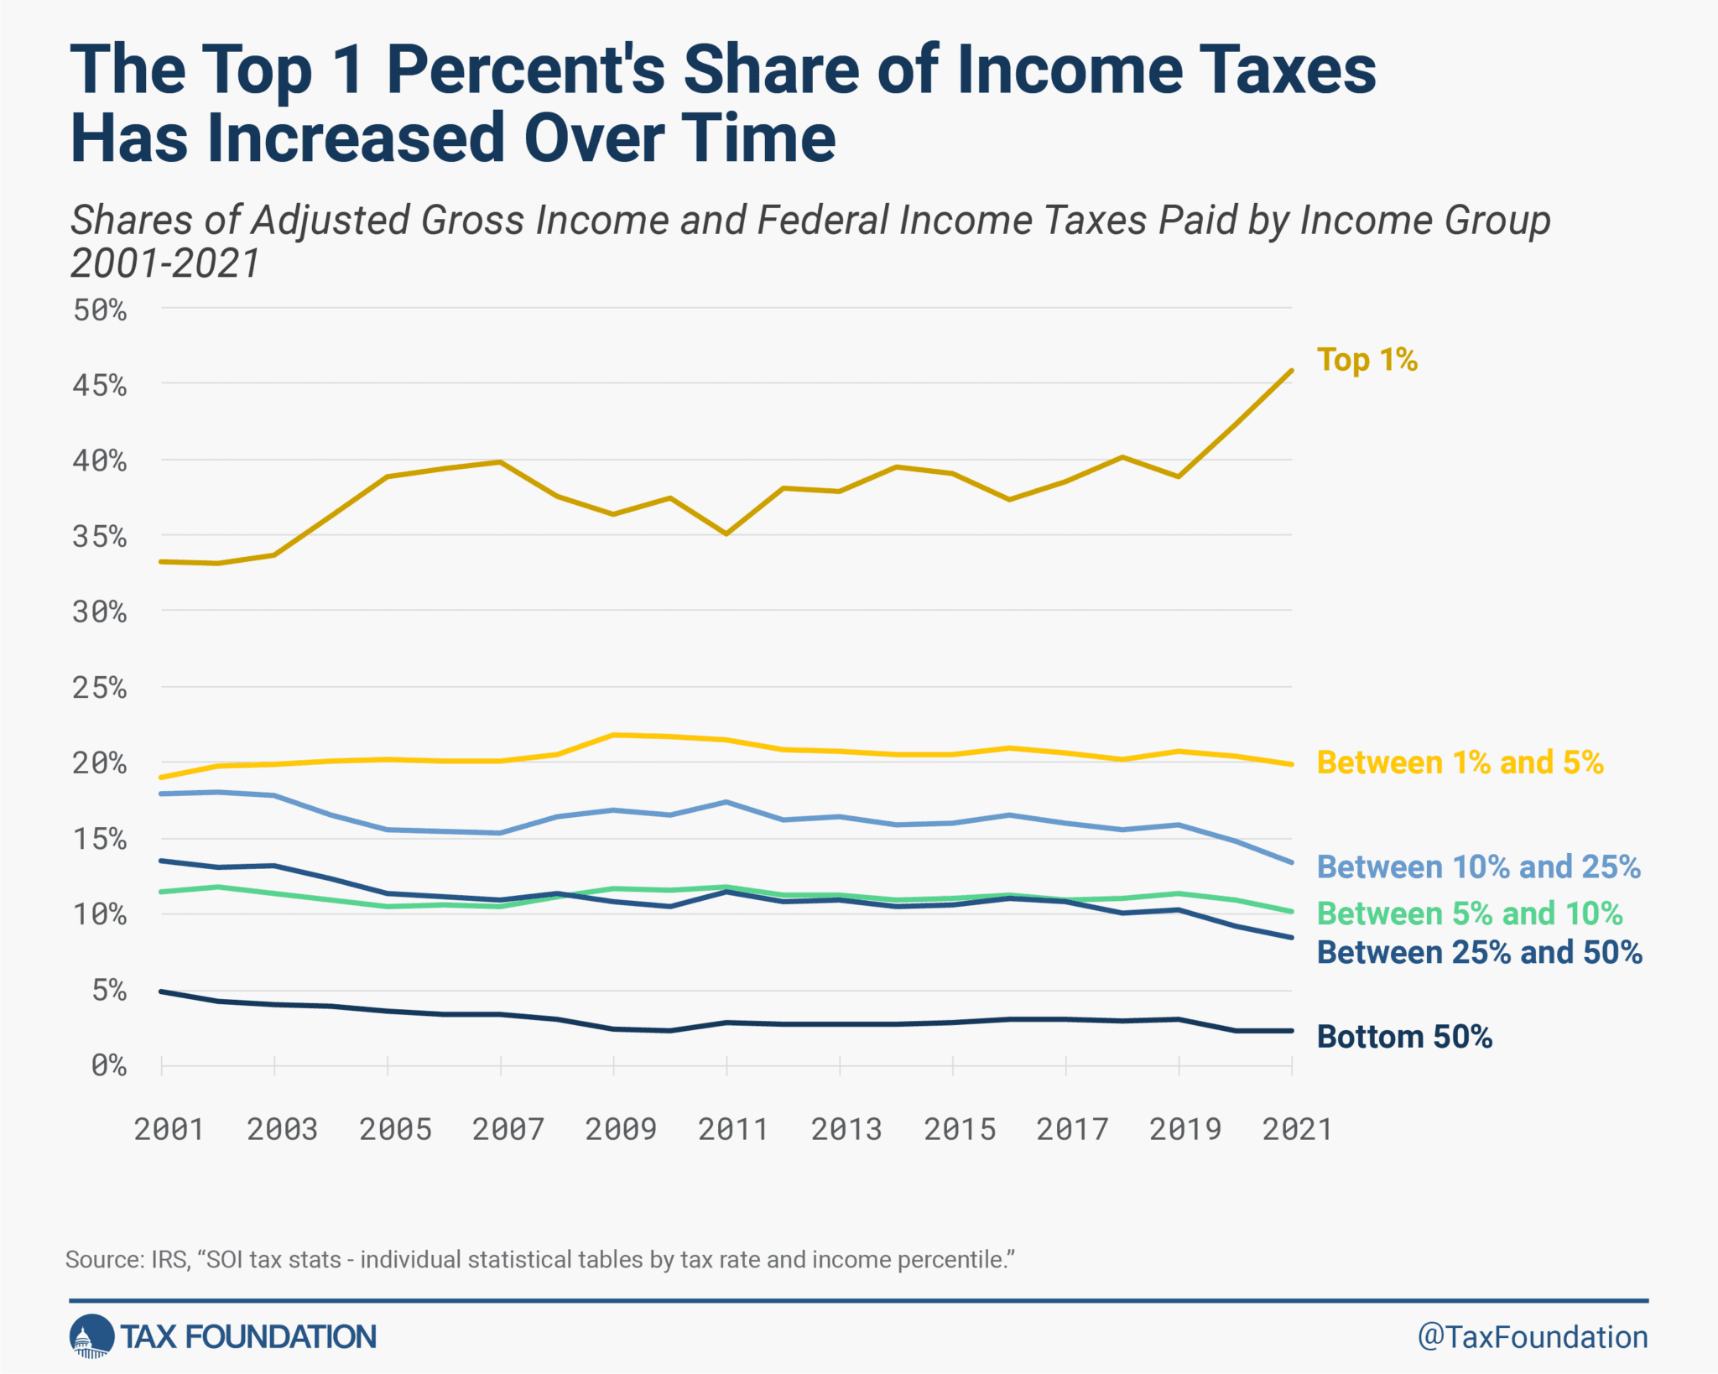
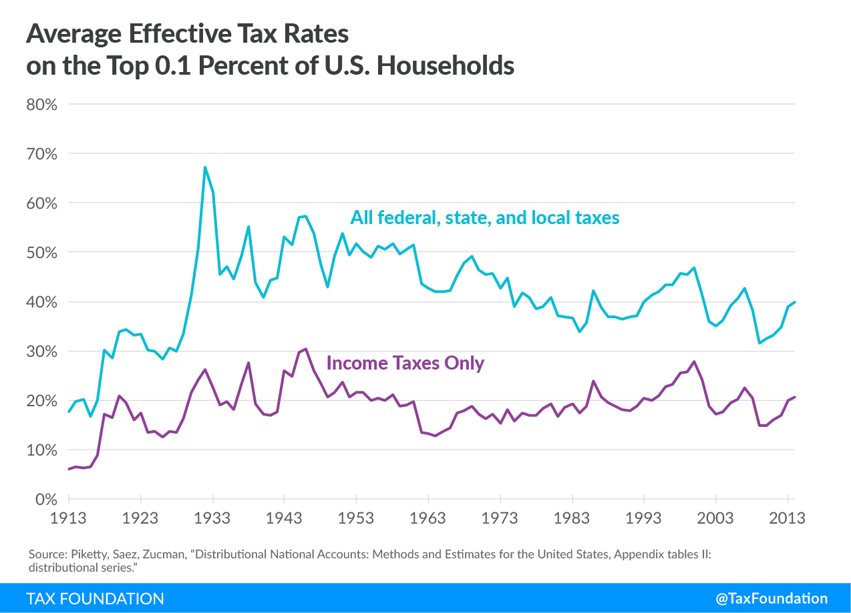
History of tax rates

Slide 35
QUESTIONS?
“Why are mortgage rates going up even though the Fed cut rates? Will they ever stop”
-Mark T.
“What would you expect to happen this year with High Yield Savings Account return rates? Key factors impacting?
-Todd E.

Slide 36
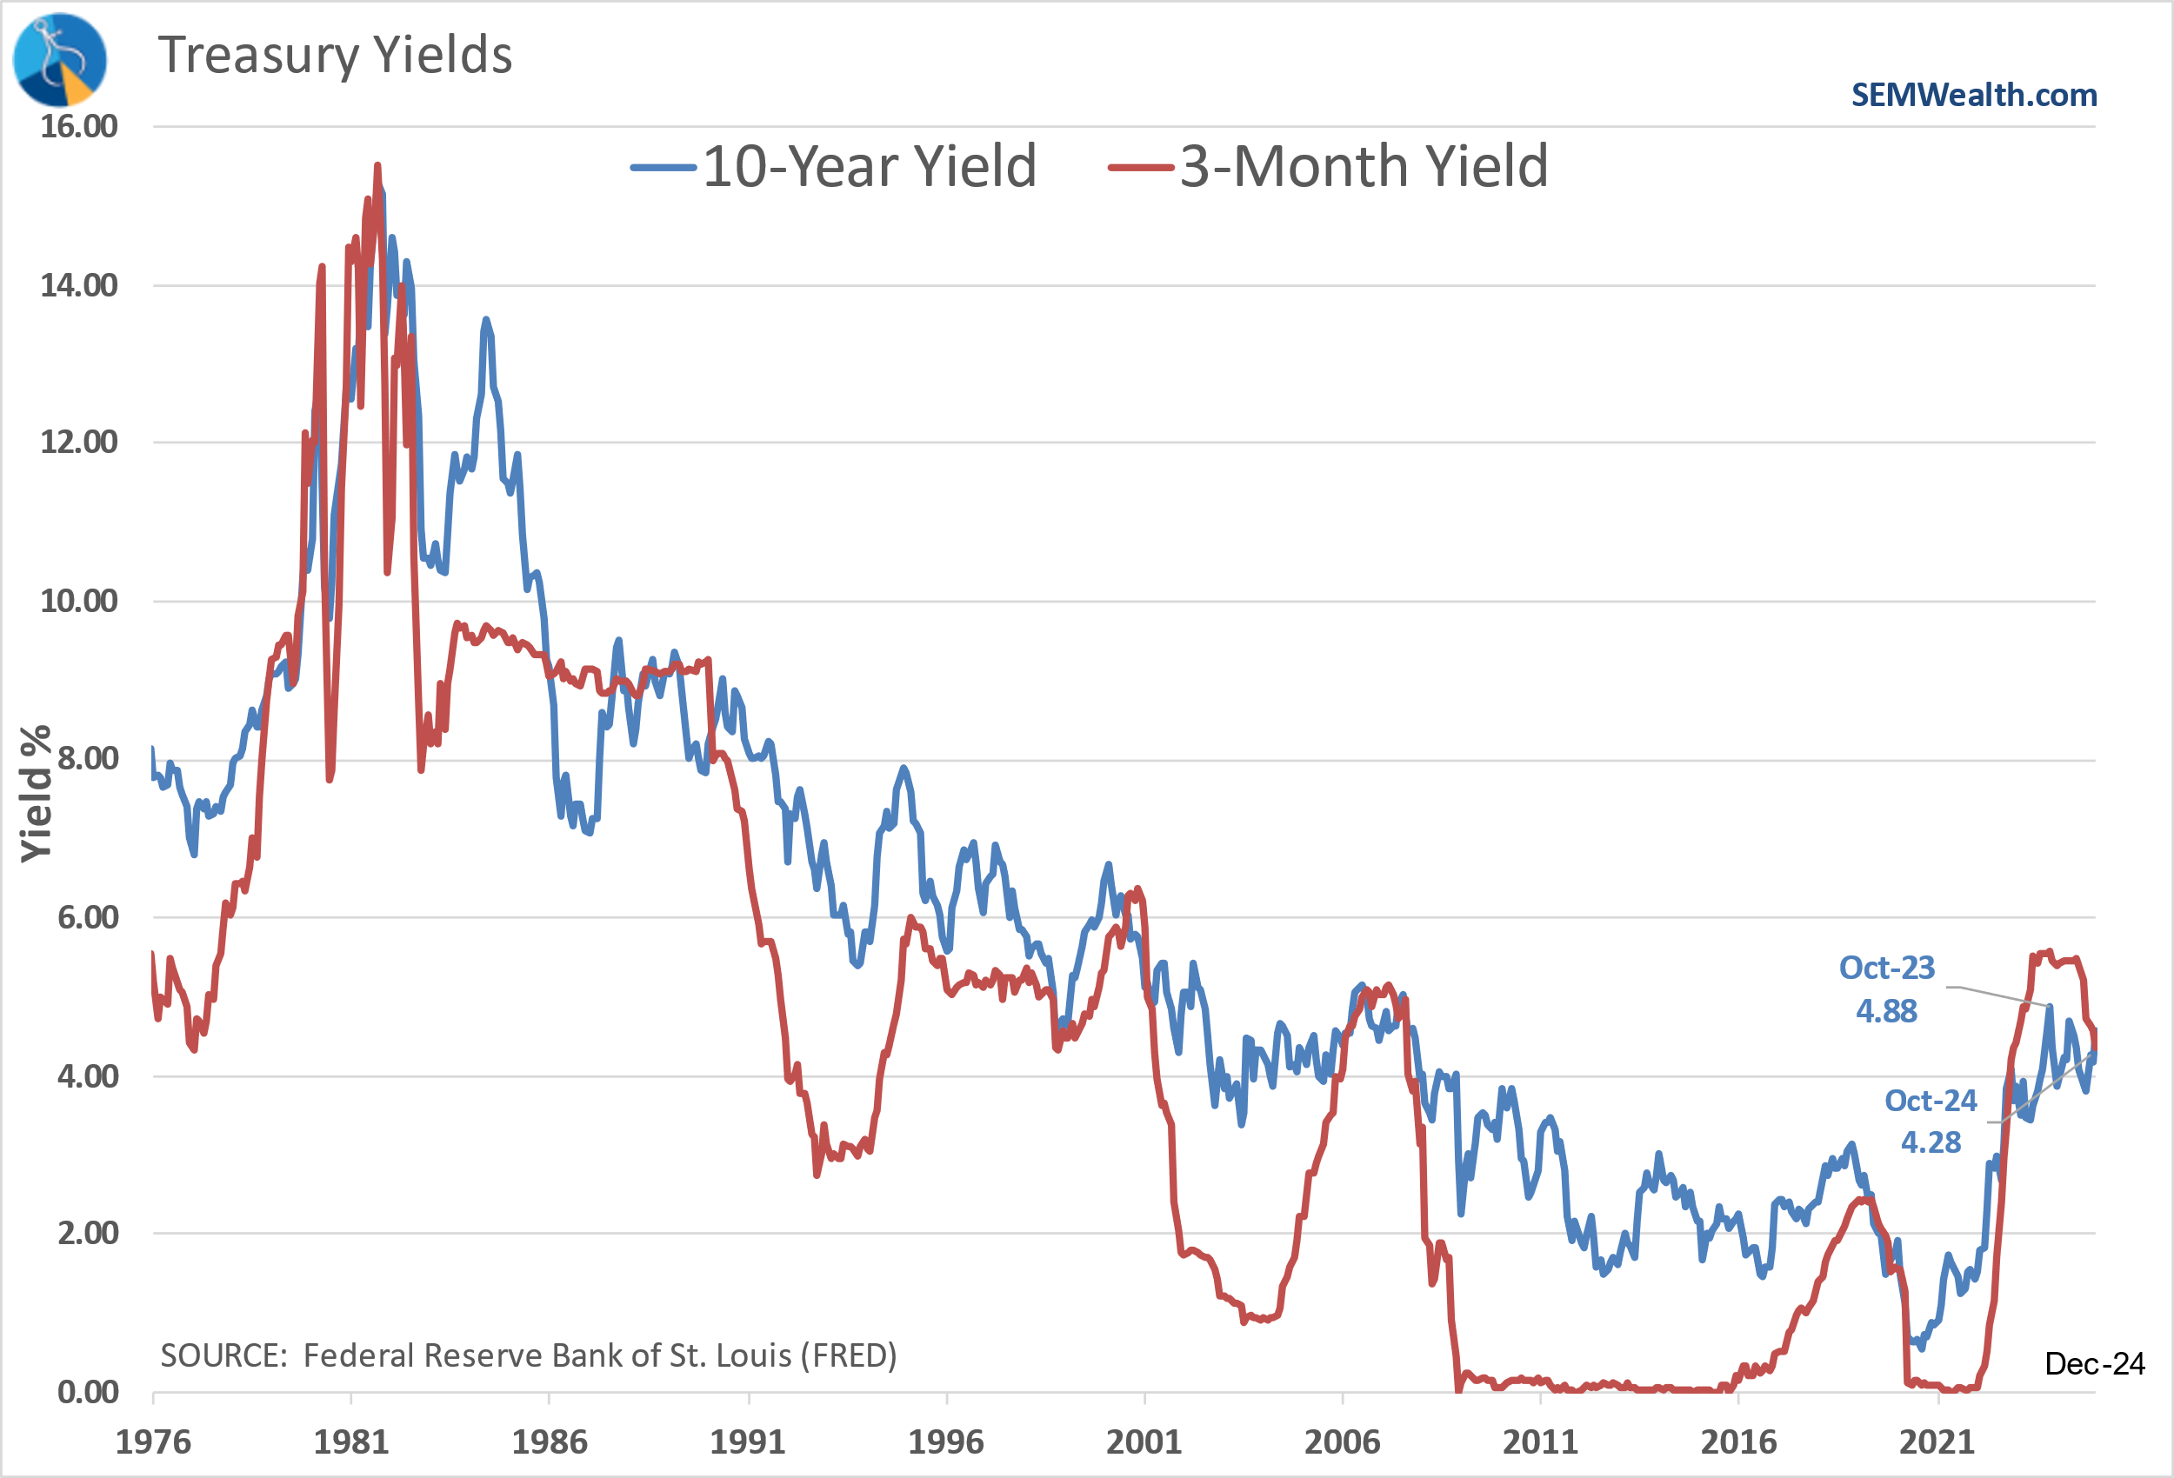
Short & Long-Term Interest Rates
INFORMATIONAL PURPOSES ONLY | NOT INVESTMENT ADVICE
Notes:
In general this is how it looks. Each customized portfolio will end up with a maximum and minimum exposure to the stock market. Over the long-run stocks should outperform, but remember rule #1 – stocks will overreact in both directions.
Looking at this chart, this is generally how our exposure fluctuates. We won’t get out right at the top or back in right at the bottom. This allows us to focus on rule #2 – managing losses is important.

Slide 37
QUESTIONS?
“What lessons did we learn from the breakup of Ma Bell and earlier Microsoft antitrust cases?”
-Brian D.

Slide 38
Lessons from Microsoft “anti-trust” cases
INFORMATIONAL PURPOSES ONLY | NOT INVESTMENT ADVICE
Notes:
In general this is how it looks. Each customized portfolio will end up with a maximum and minimum exposure to the stock market. Over the long-run stocks should outperform, but remember rule #1 – stocks will overreact in both directions.
Looking at this chart, this is generally how our exposure fluctuates. We won’t get out right at the top or back in right at the bottom. This allows us to focus on rule #2 – managing losses is important.

Slide 39
QUESTIONS?
“With Donald trump’s inauguration set for Monday, should I buy more of my current stocks? If I recall correctly, last time his inauguration happened stocks skyrocketed. Just looking for a little advice and I won’t hold you accountable. Thanks!”
-Nicole S.

Slide 40
Beware the Trade War Part II

Slide 41
QUESTIONS?

Slide 42
SEM Wealth Management
Founded in 1992 by Richard Gage a metallurgical engineer
Co-owner and Chief Investment Officer, Jeff Hybiak, CFA joined in 1998
Background in accounting and traditional portfolio management (MPT)
Outsourced Chief Investment Officer (OCIO) for Financial Planners throughout the country (~2700 accounts)
Total AUM = $880M as of 12/31/2024
Primary Custodian is Axos Advisor Services
Select models also available on
Adhesion/FlexUMA
Axiom (Geneos Wealth Management)
Via subscription services
Systematic, data-driven process designed to remove behavioral biases from all areas of the investment process
3 Distinct Management Styles – Tactical, Dynamic, and Strategic

Slide 43
Disclaimer

